Slide 1
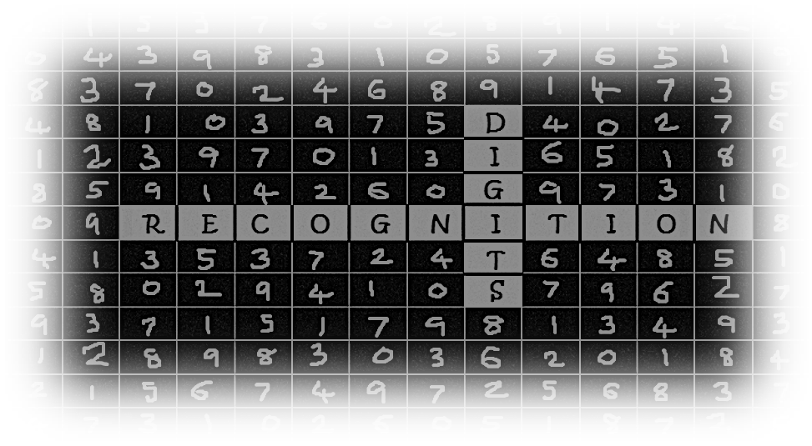
presented by
Akshaya Balamurugan
A0178458L
KE – 30 FT
National University of Singapore
A Deep Learning solution for
MNIST digits data

Slide 2
A Proposed Solution
MNIST Dataset
DL using NN
Image Data
TensorFlow
Basic Implementation
Data Processing
Model Building
Model Evaluation
Notes:
https://www.analyticsvidhya.com/blog/2016/10/an-introduction-to-implementing-neural-networks-using-tensorflow/
http://www.aisoftwarellc.com/blog/post/digit-classification-with-tensorflow-and-the-mnist-dataset/2039
http://neuralnetworksanddeeplearning.com/chap1.html
https://dzone.com/articles/exploring-handwritten-digit-classification-a-tidy

Slide 3
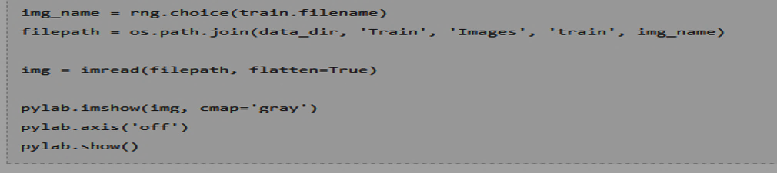
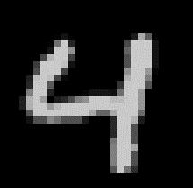
Demo Samples

Slide 4
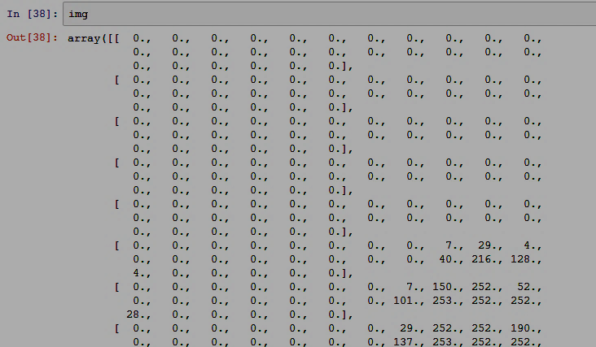
Demo Samples

Slide 5
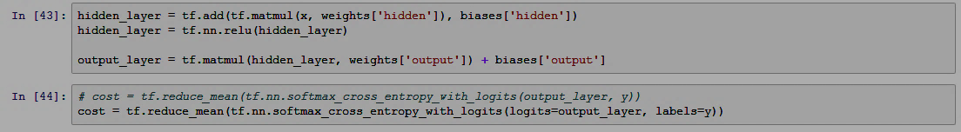
Demo Samples

Slide 6
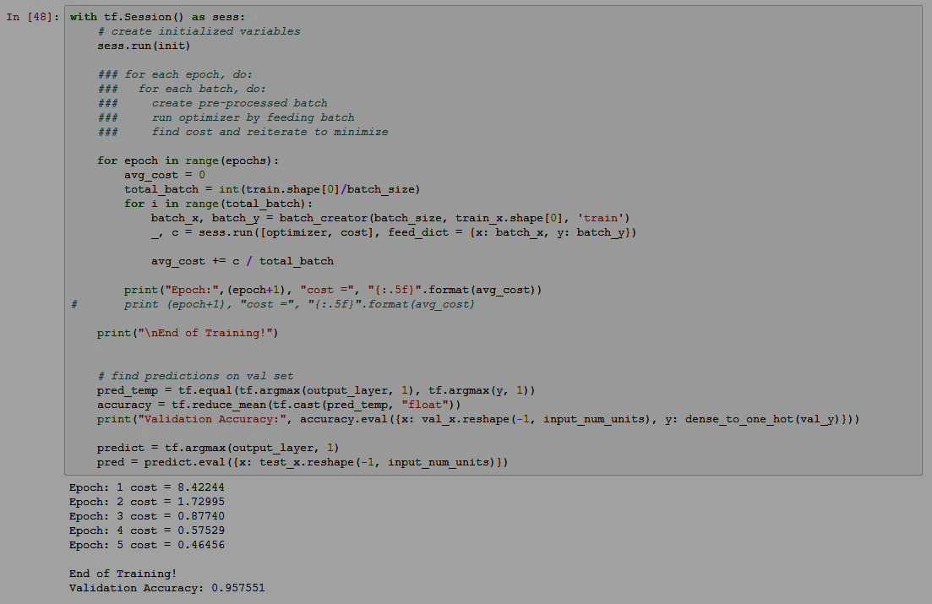
Demo Samples (contd.)

Slide 7
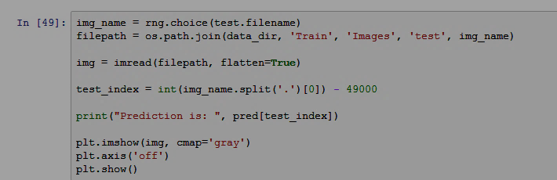
Demo Samples (contd.)

Slide 8
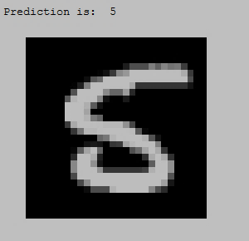
Demo Samples (contd.)

Slide 9
Potential business – The Future
Pattern Recognition
Almost all industries require
clever image-based apps
Life Sciences
Employed in surgical robots
Augmented Virtual Reality
Computer vision projects
Manufacturing
Real time energy monitoring systems
Speech and NLP
PDAs, Chatbots
Notes:
https://dzone.com/articles/neural-networks-user-guide-for-business
http://ieeexplore.ieee.org/document/8109042/?reload=true
https://knowm.org/mnist-hand-written-digits-classification-benchmark/

Slide 10
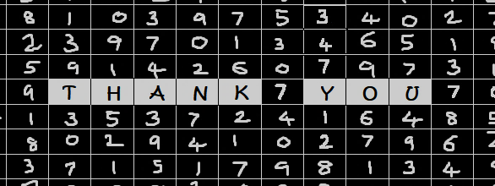
Notes:
Talk about reference section for the complete code and basic transcript of speaker notes

